Slide 1
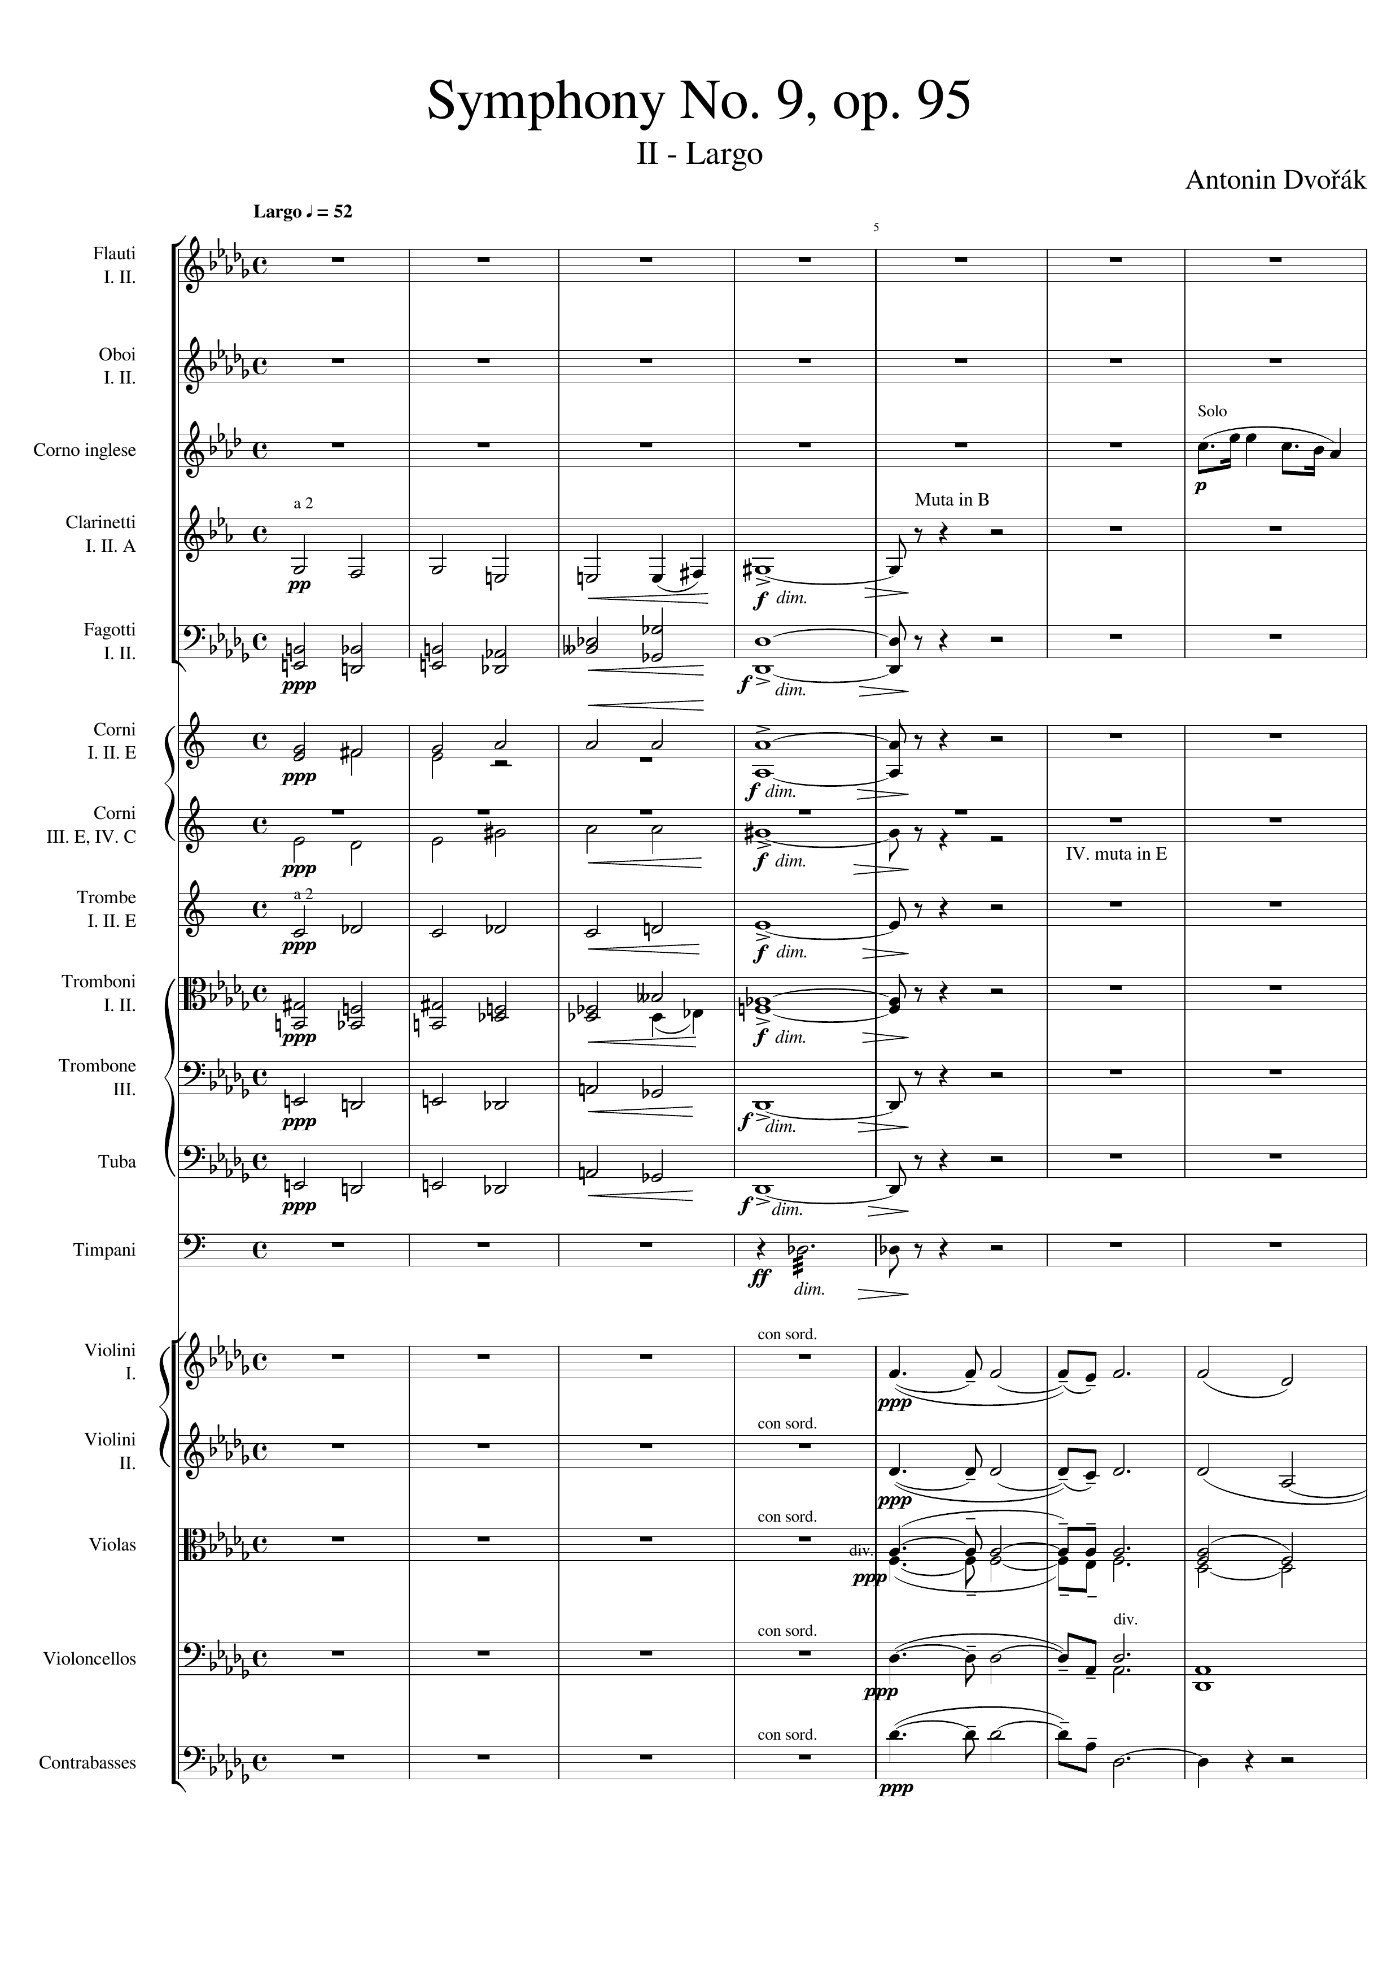
mel
harm
harm
harm
harm
mel
harm
harm
mel
harm
harm
rhythm
harm
harm
harm
harm
harm

Slide 2
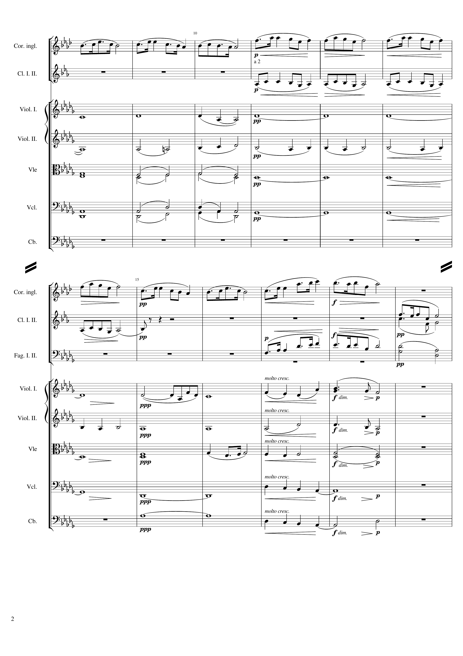
mel
mel
harm
harm
harm
harm
mel
mel
mel
mel
harm
harm
harm
harm
harm
harm

Slide 3
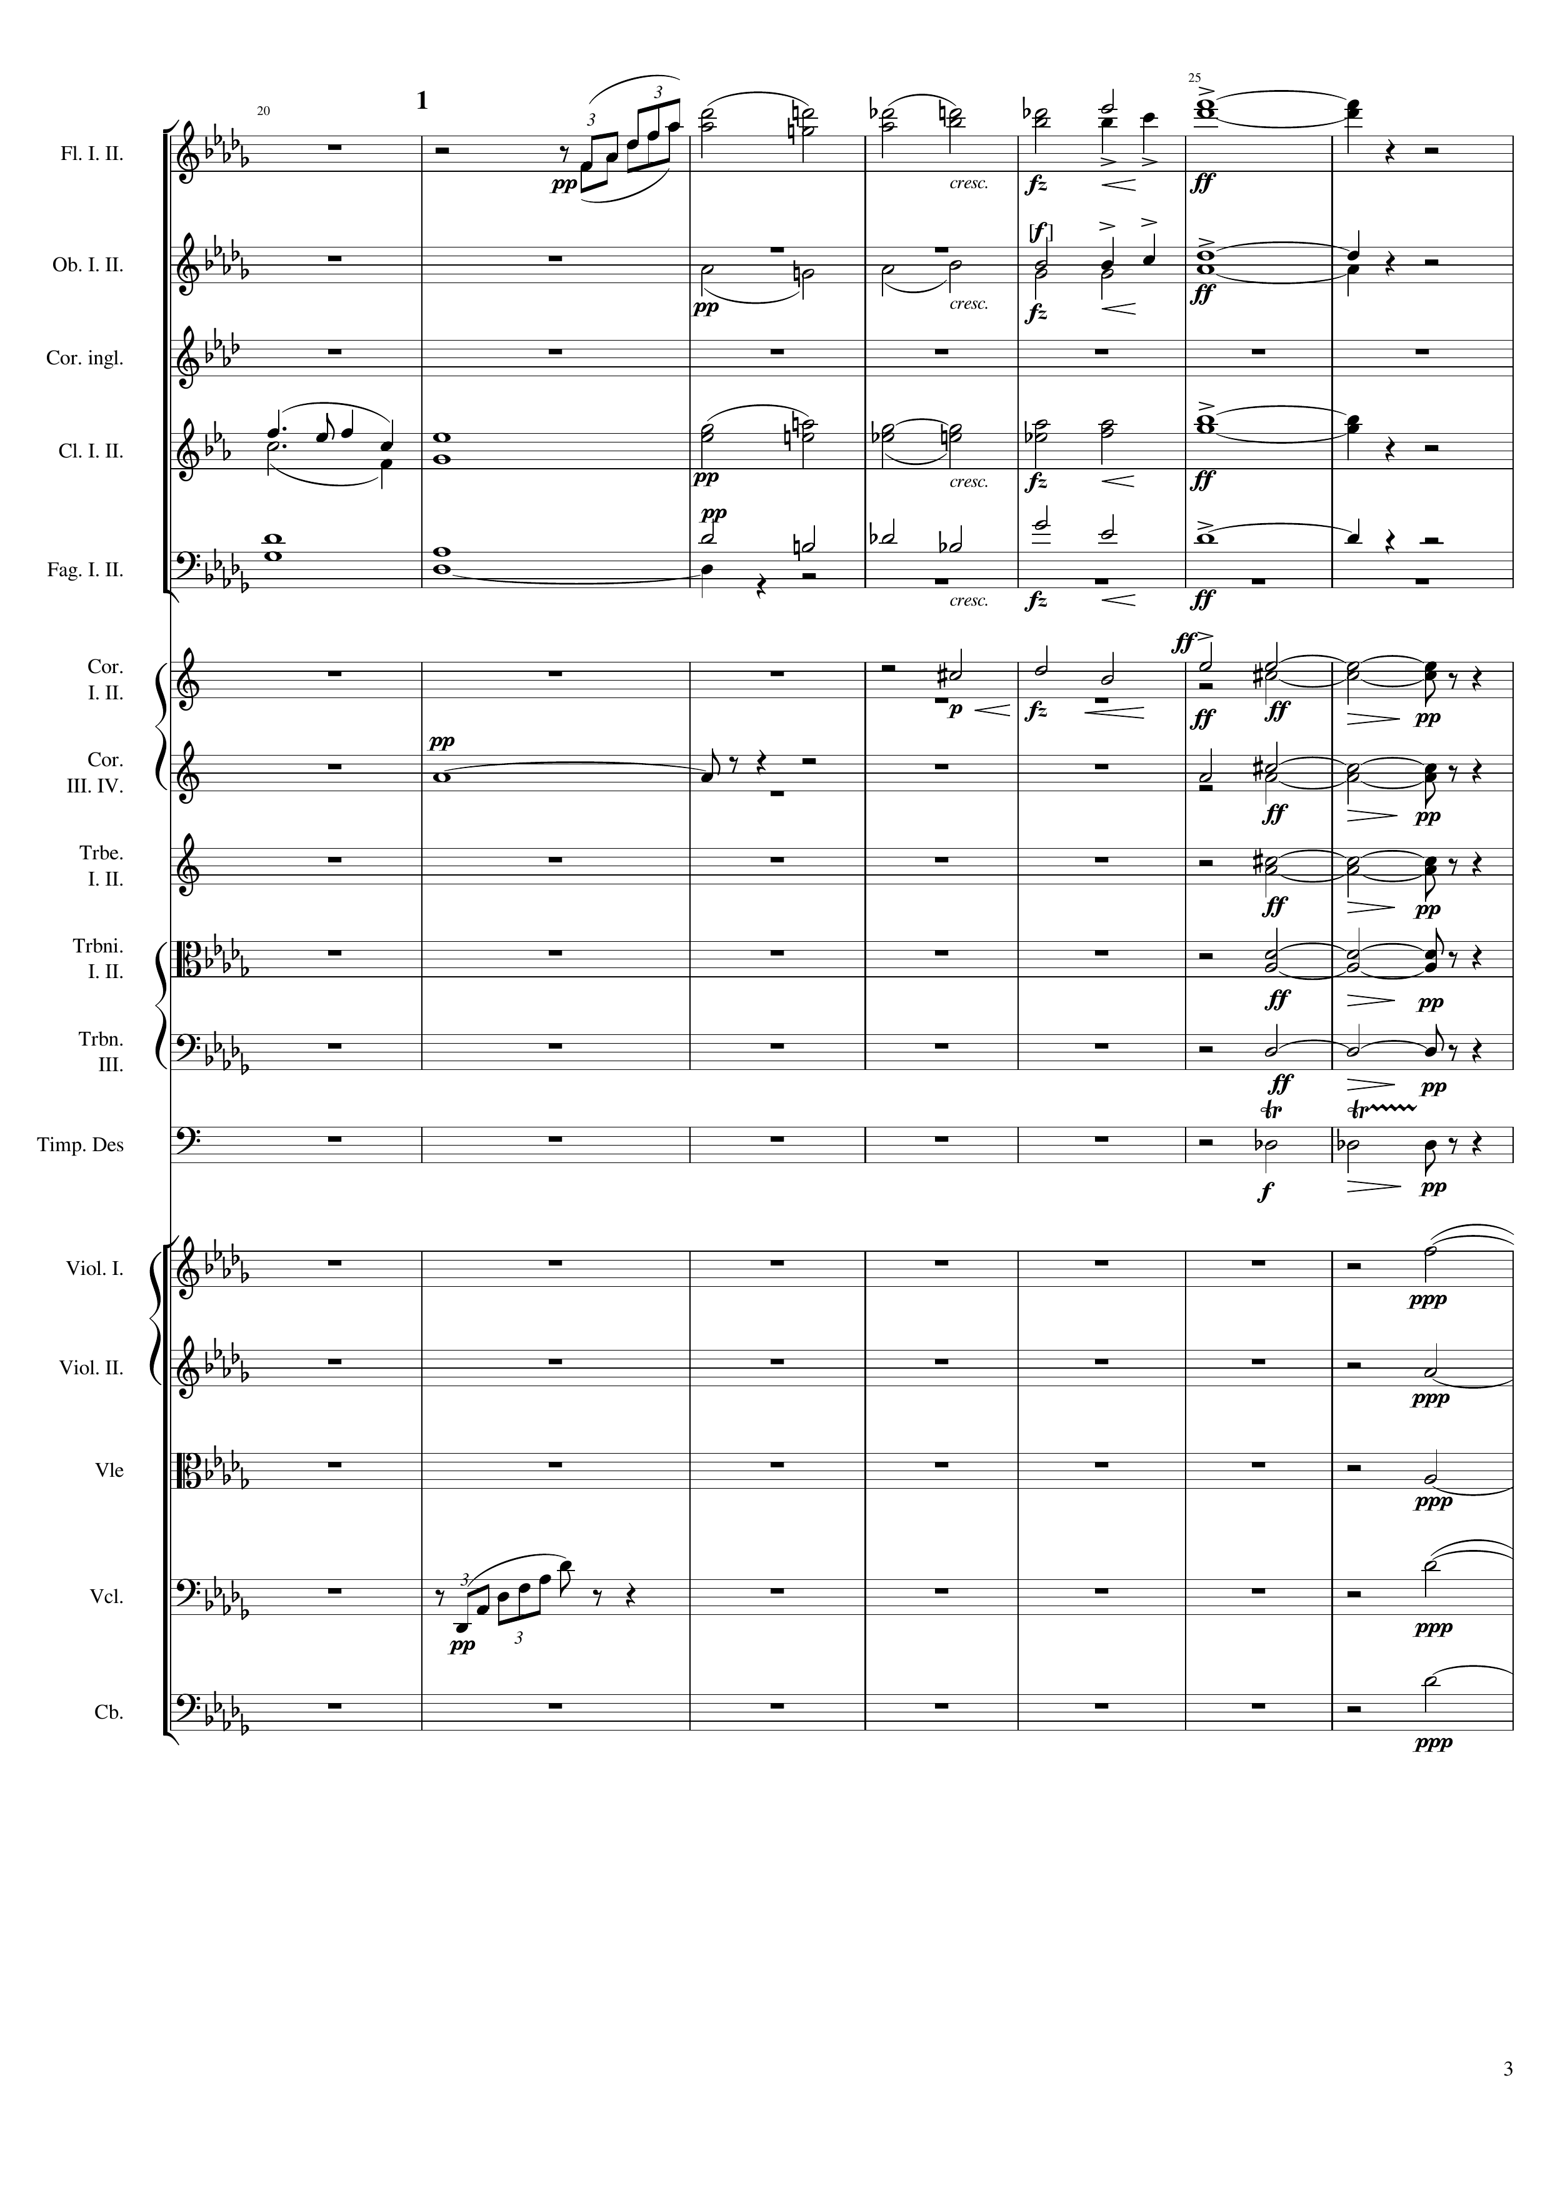
mel
mel
harm
mel
harm
harm
harm
harm
v
mel
harm
harm
harm
mel
harm
harm
rhythm
mel
mel

Slide 4
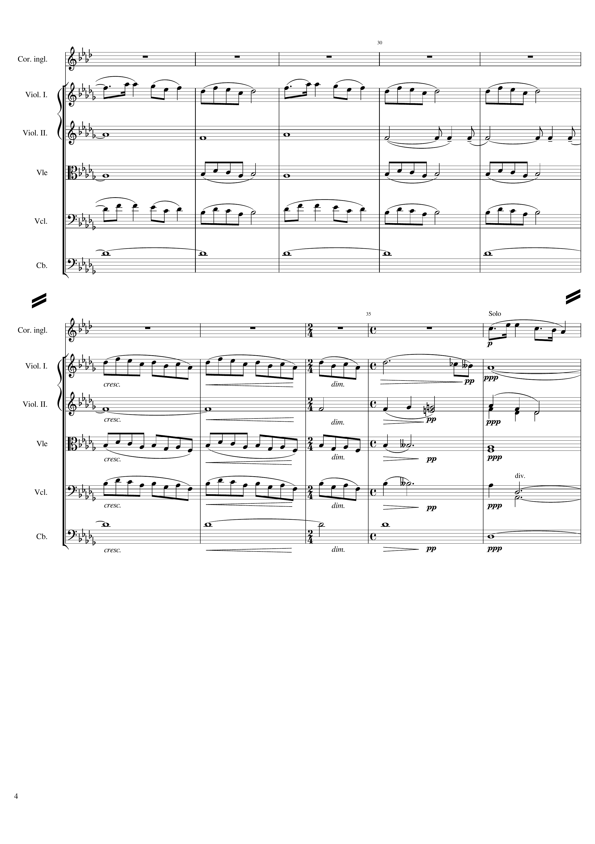
mel
harm
harm
mel
harm
mel
mel
mel
harm
mel
mel
harm
harm
harm
mel
harm
mel
harm
harm

Slide 5
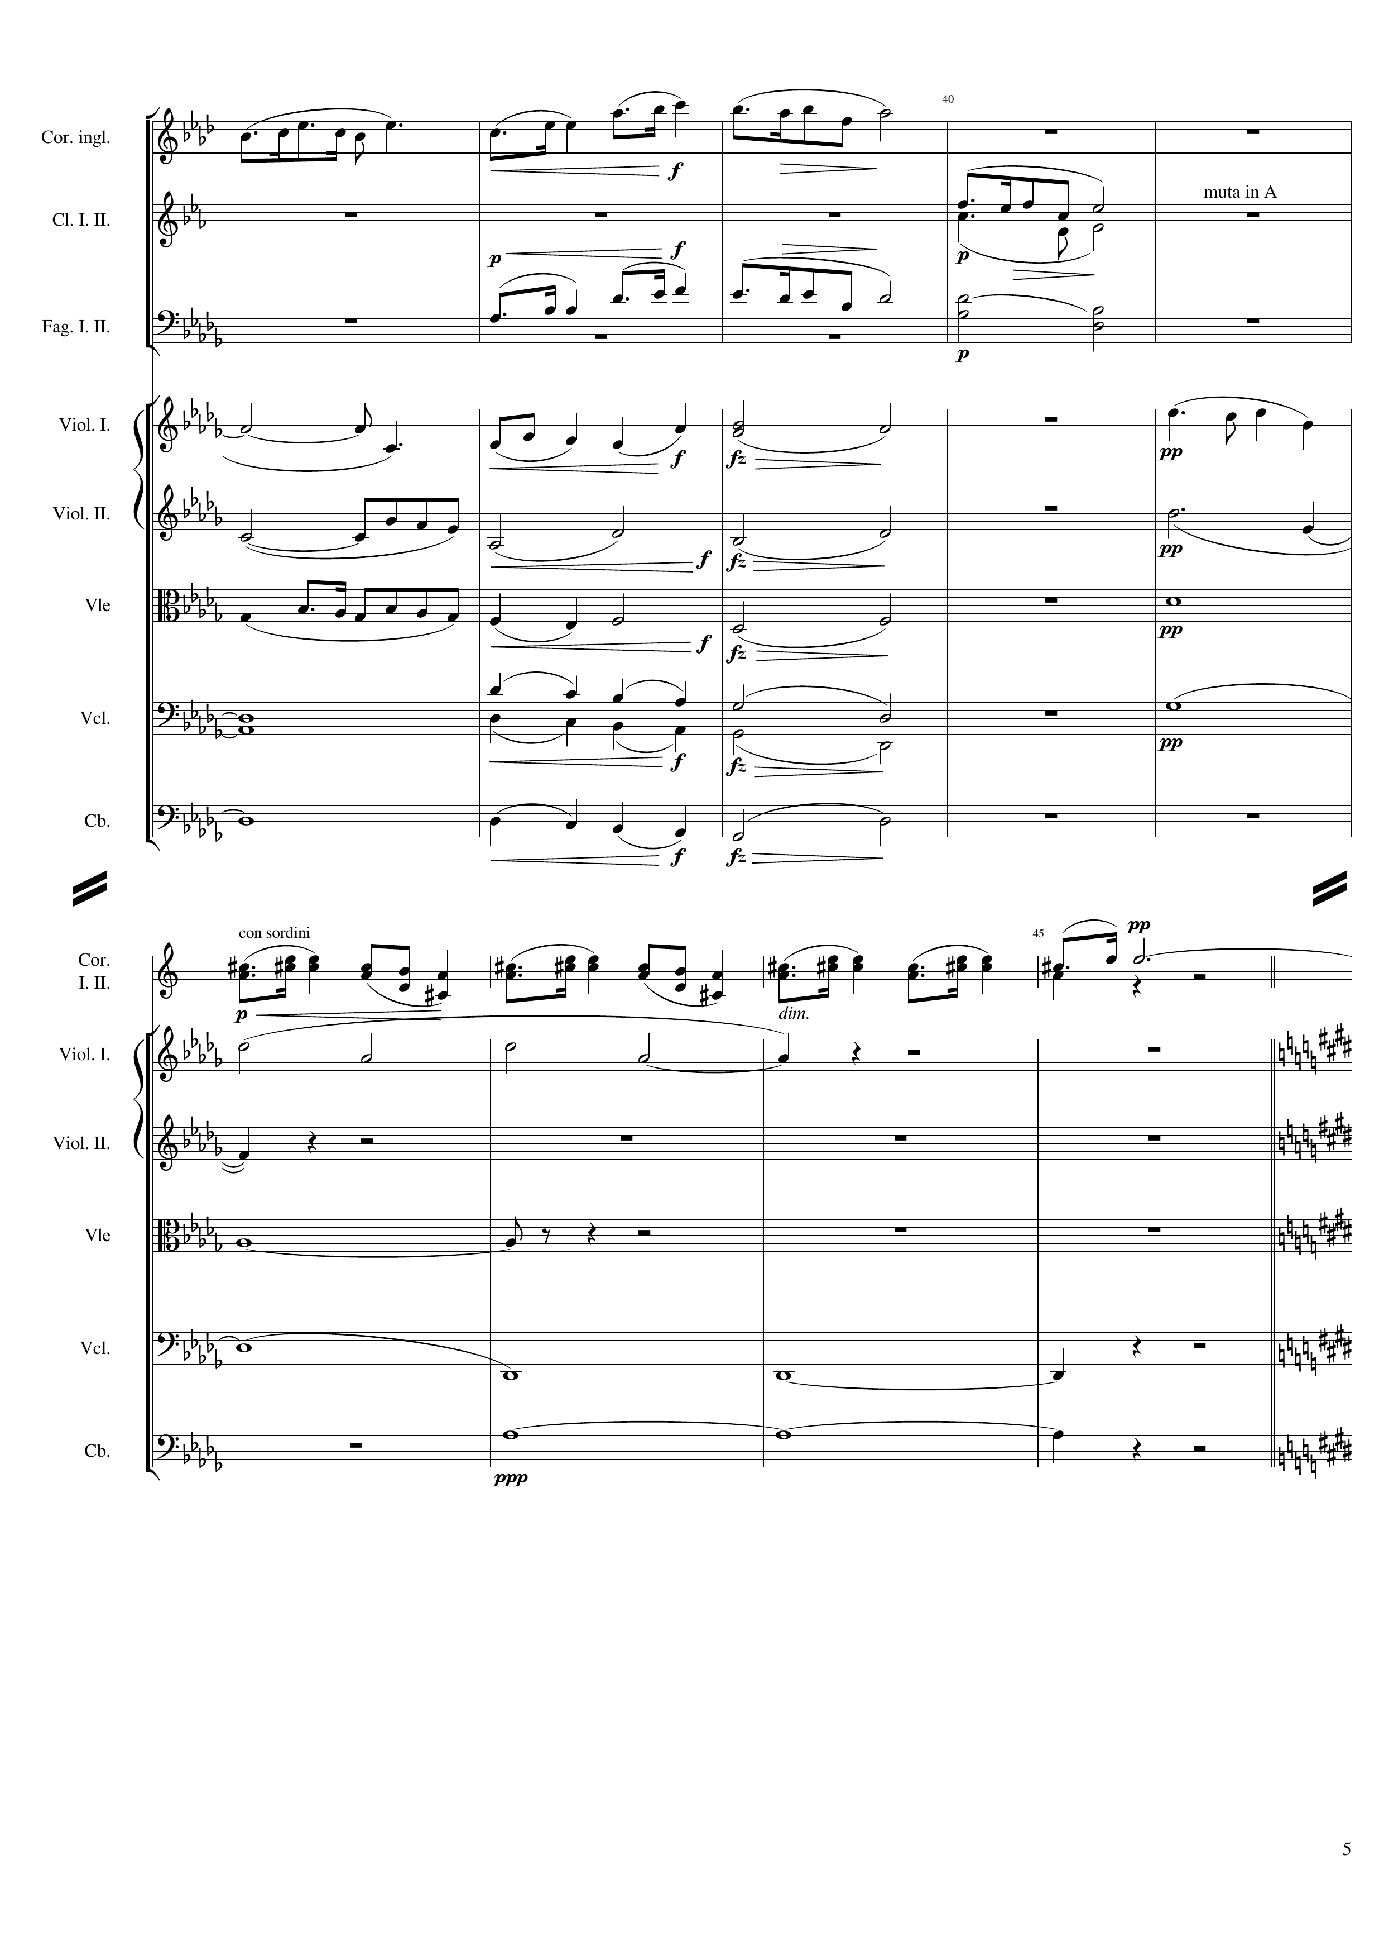
mel
mel
mel
harm
harm
mel
harm
mel
harm
harm
harm
mel
harm
harm
harm
harm
harm
mel
mel
harm
harm
harm
harm
harm

Slide 6
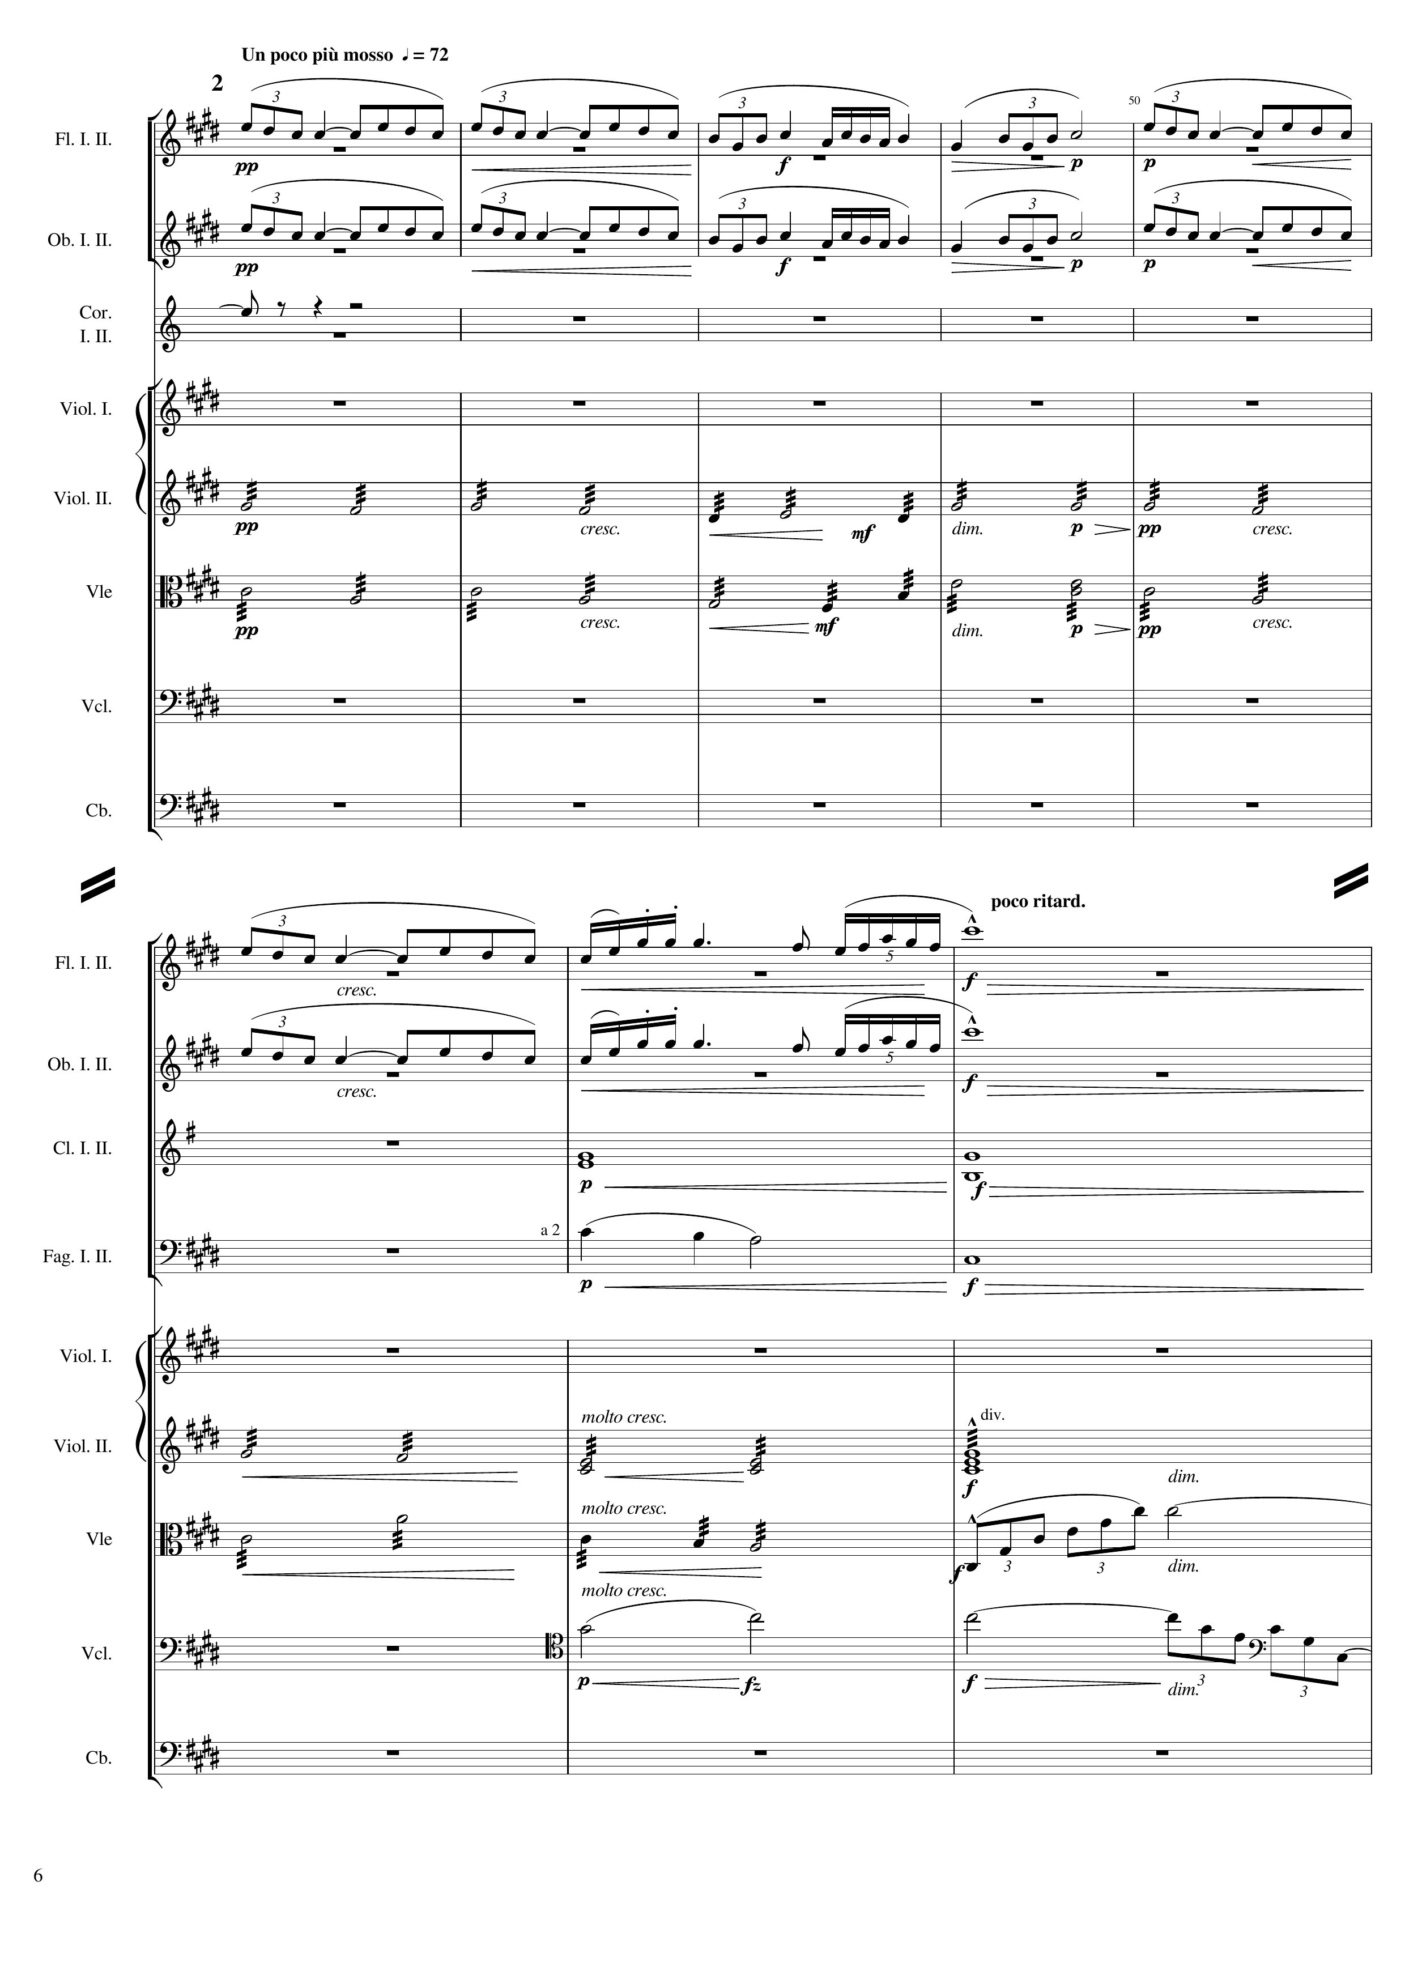
mel
mel
////////////90-
mel
////////////90-
rhythm+harm
rhythm+harm
mel
////////////90-
mel
////////////90-
harm
harm
rhythm+harm
rhythm+harm
mel
////////////90-
harm
mel
////////////90-

Slide 7
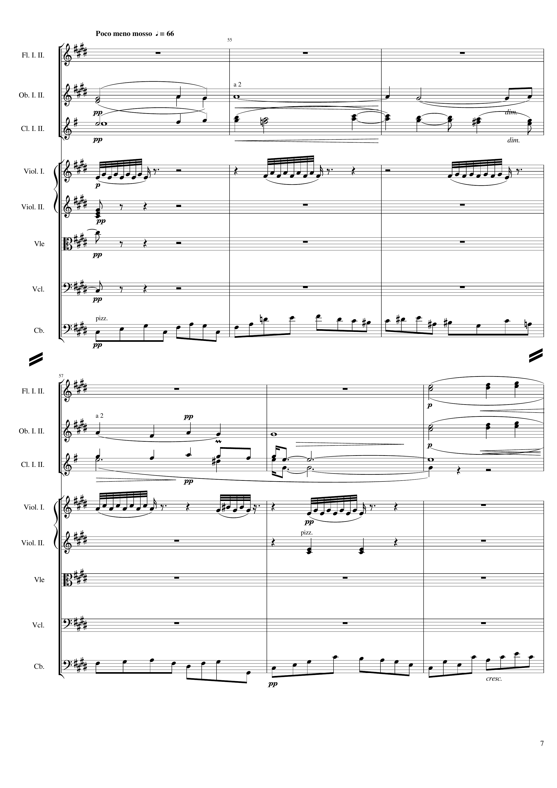
mel
mel
rhythm
rhythm
rhythm
harm
mel
mel
mel+rhythm
mel
mel
mel
mel
harm
rhythm
rhythm
rhythm
harm
mel+rhythm

Slide 8
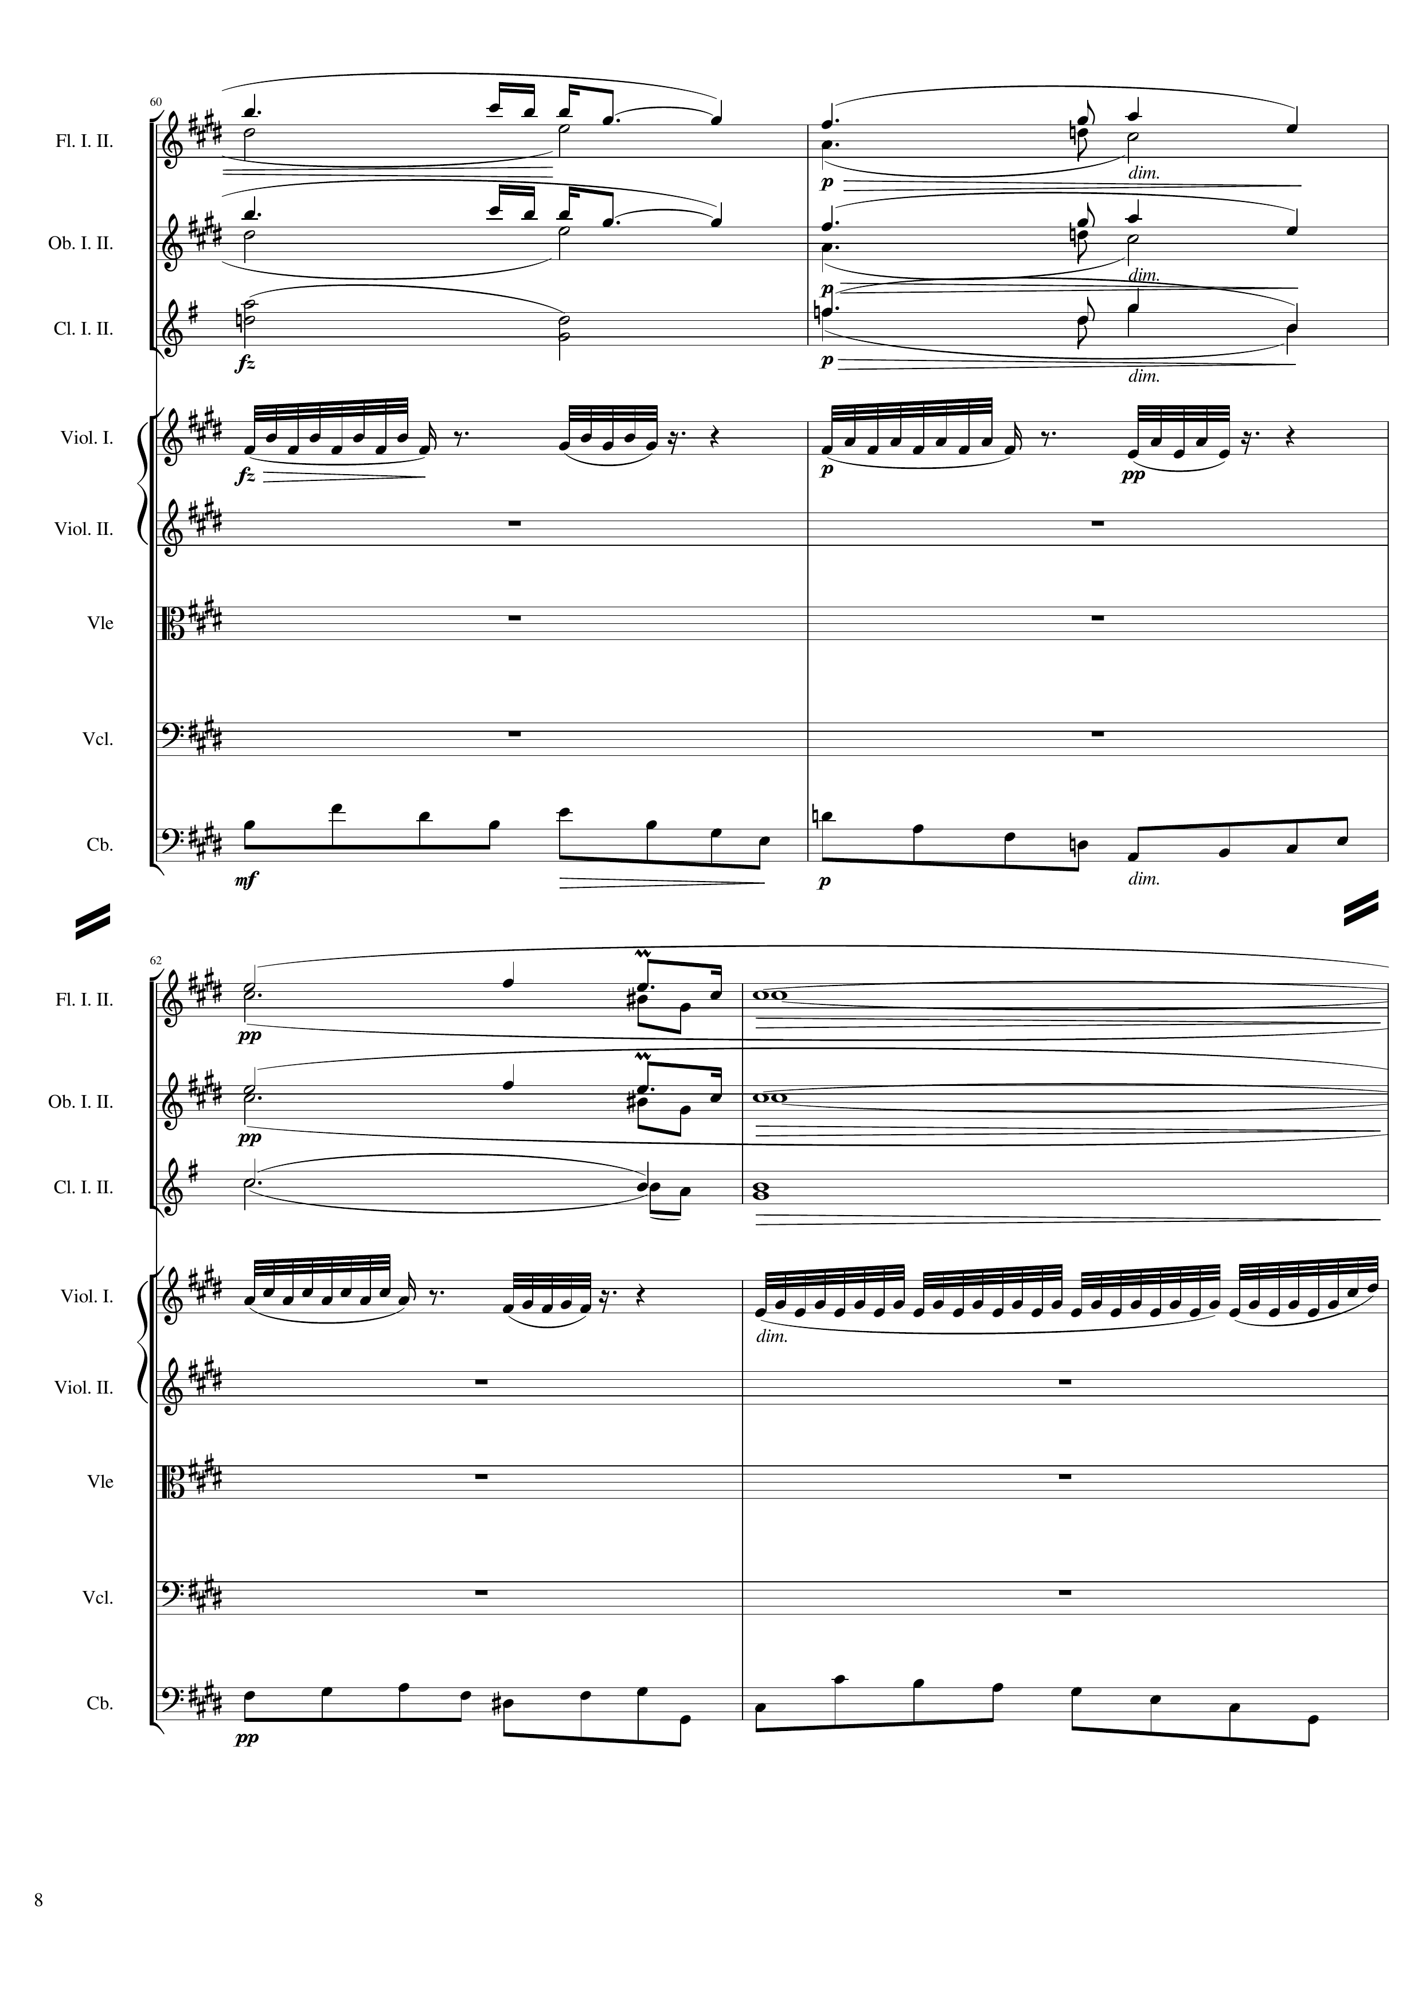
mel
harm
mel
harm
harm
rhythm
mel+rhythm
mel
harm
mel
harm
harm
rhythm
mel+rhythm

Slide 9
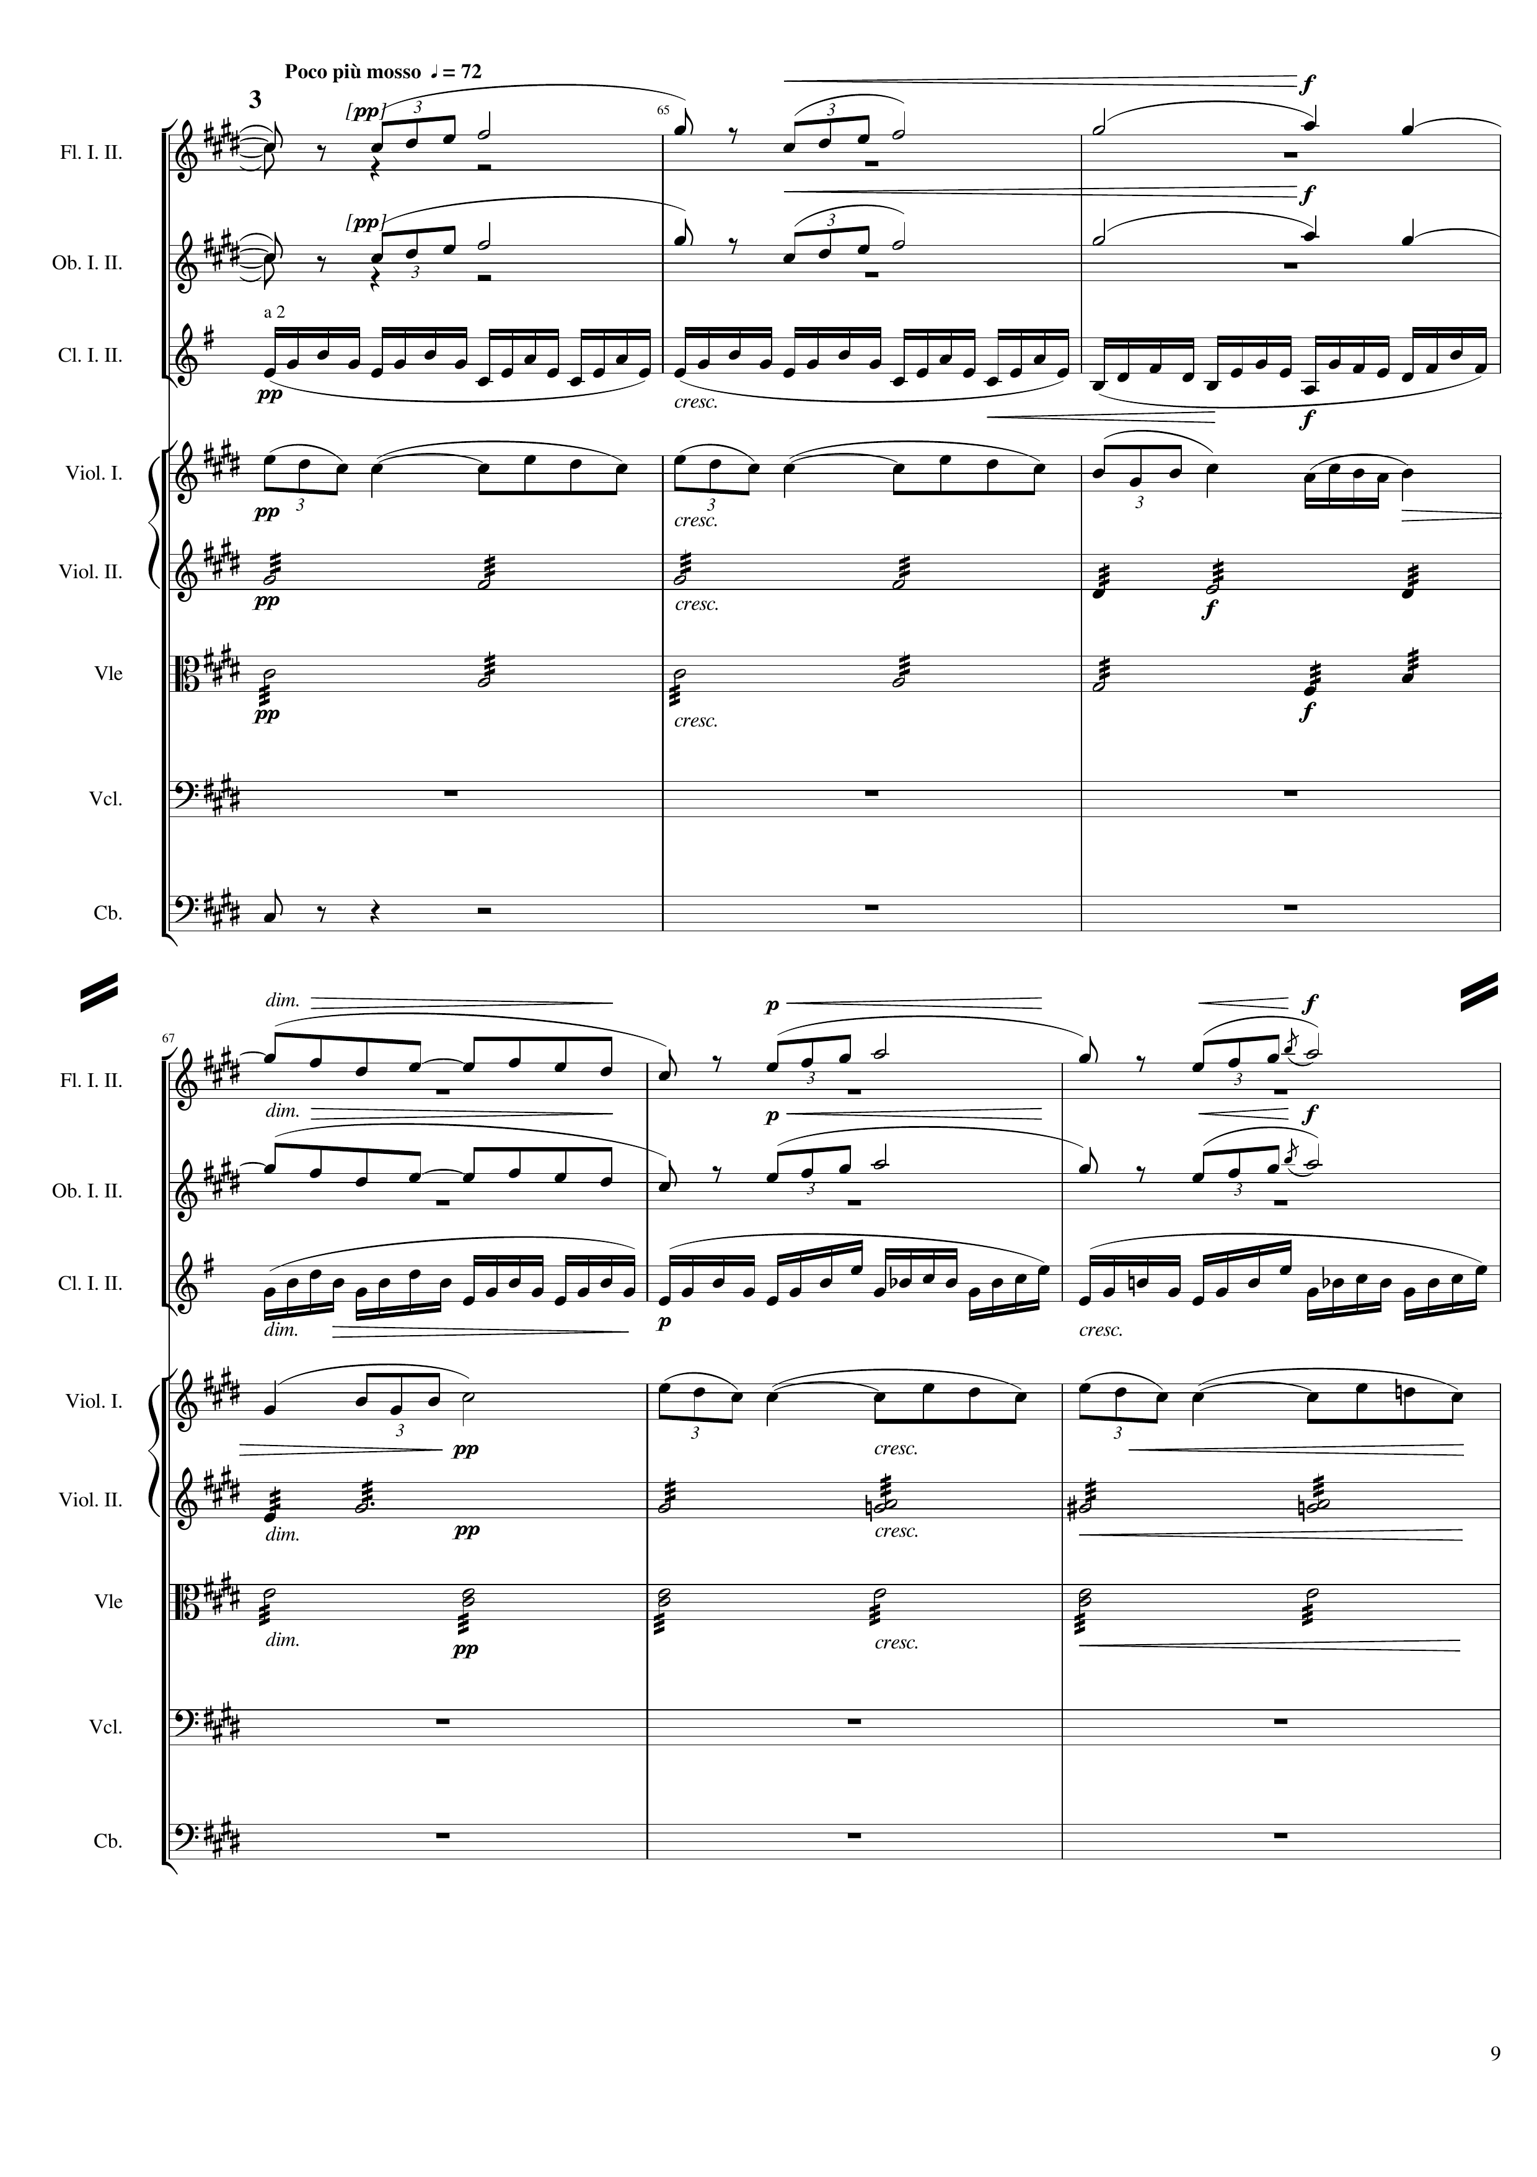
mel
mel
rhythm
mel
rhythm+harm
rhythm+harm
rhythm
mel
mel
rhythm
mel
rhythm+harm
rhythm+harm

Slide 10
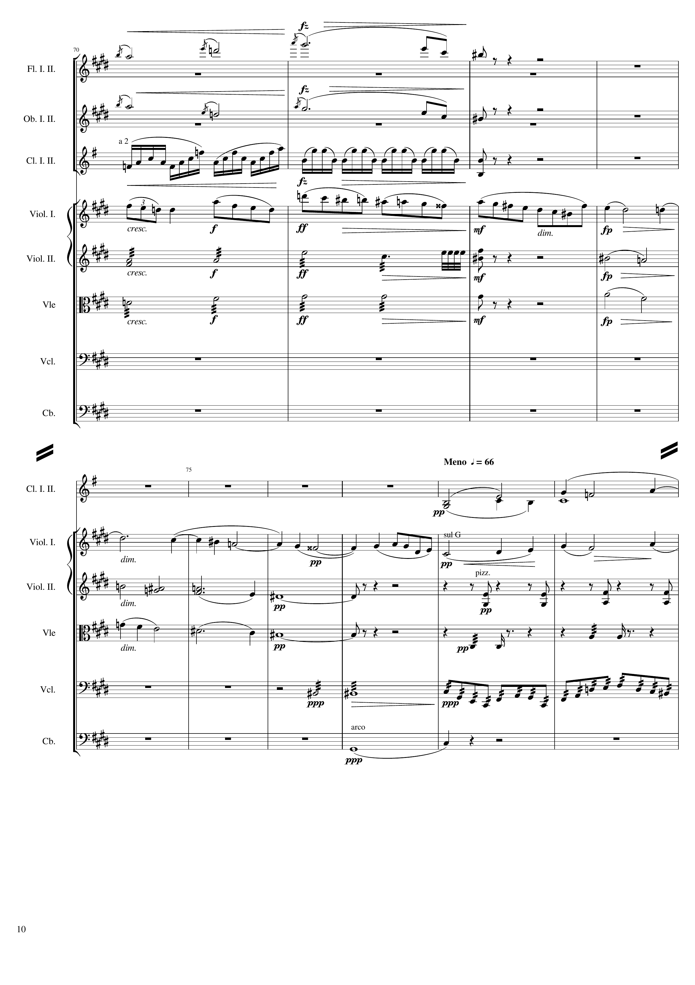
mel
mel
rhythm
mel
rhythm+harm
harm
rhythm+harm
harm
harm
mel
harm
mel
harm
rhythm+harm
mel
rhythm
rhythm
mel+rhythm
harm

Slide 11
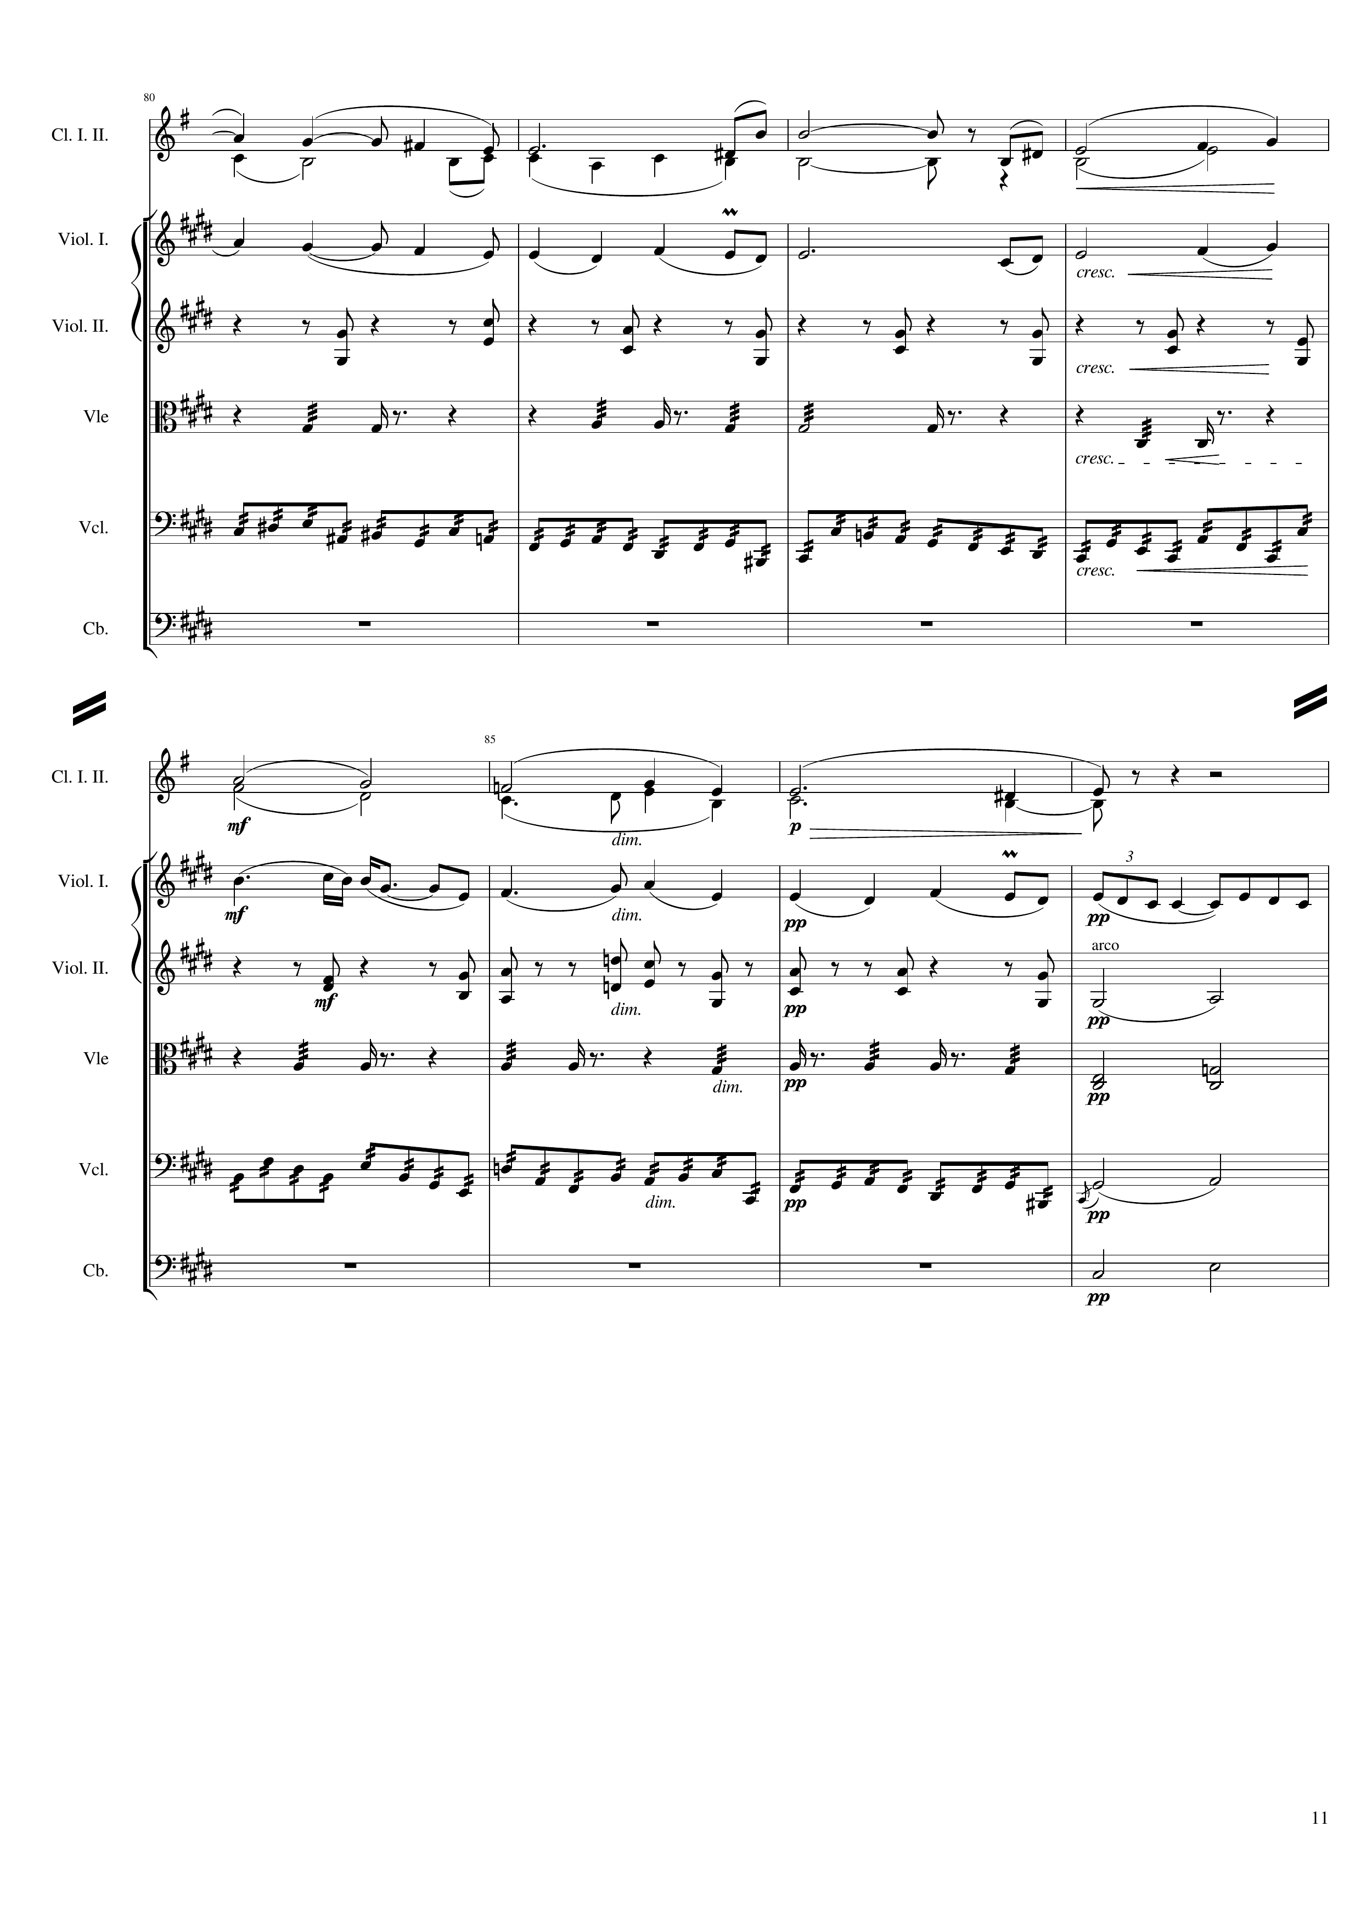
mel
harm
harm
mel
rhythm+harm
rhythm
mel+rhythm
harm
mel
rhythm+harm
harm
rhythm
harm
mel+rhythm
harm
harm

Slide 12
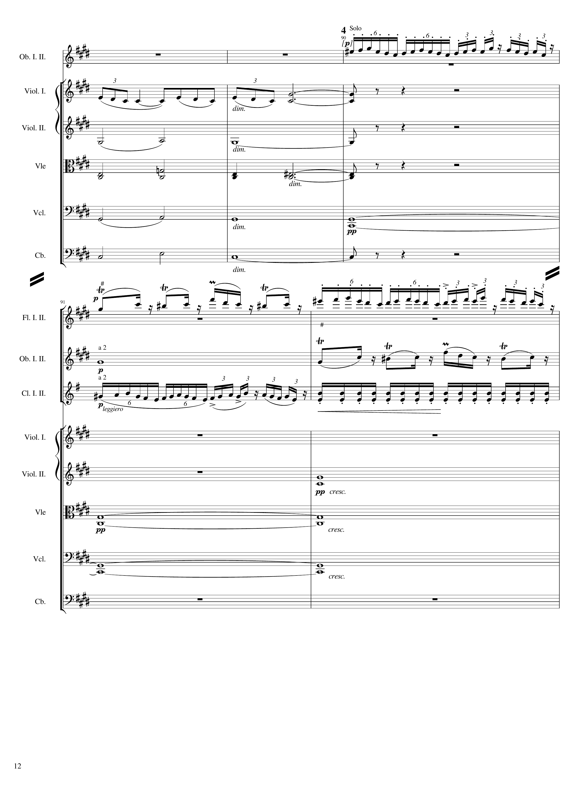
mel+rhythm
mel
harm
harm
harm
harm
mel
mel+rhythm
harm
mel
mel+rhythm
rhythm
harm
harm
harm

Slide 13
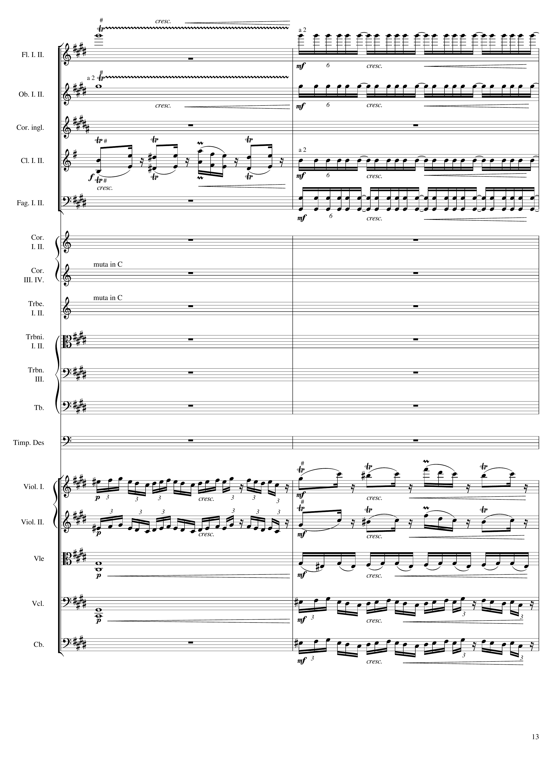
rhythm
rhythm
mel
rhythm
rhythm
mel+rhythm
mel
mel+rhythm
mel
harm
harm
mel+rhythm
mel+rhythm

Slide 14
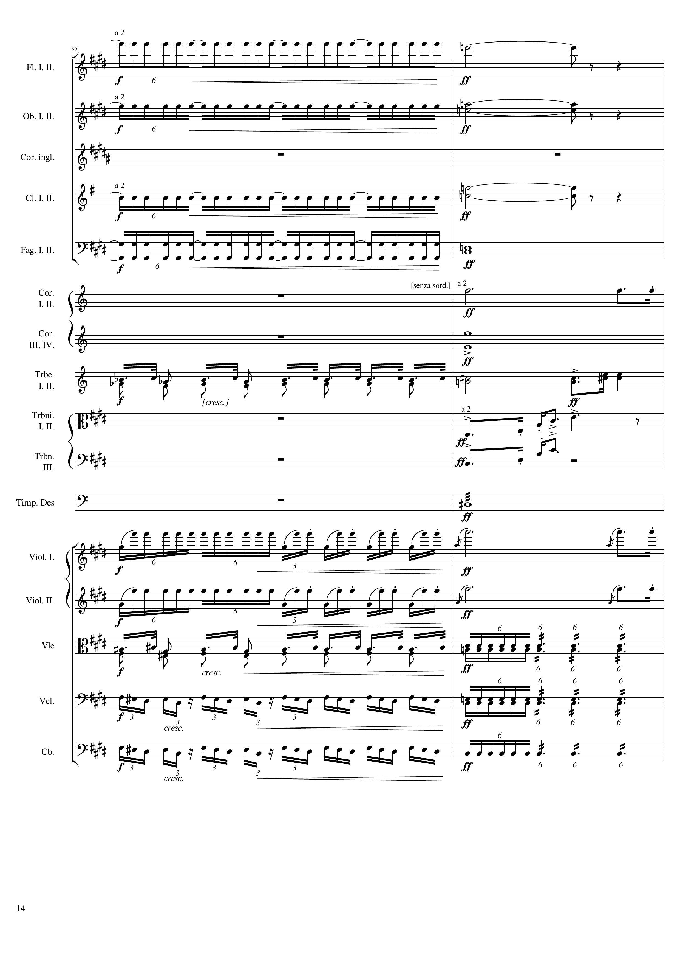
rhythm
harm
rhythm
harm
rhythm
harm
rhythm
harm
harm
mel
harm
mel
mel
mel
rhythm
rhythm
mel
rhythm
mel
mel
rhythm+harm
mel+rhythm
rhythm+harm
mel+rhythm
rhythm+harm

Slide 15
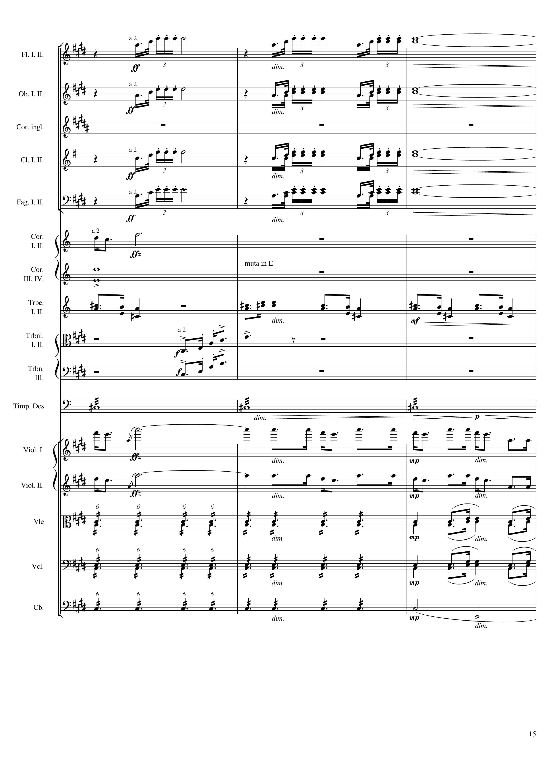
rhythm+harm
harm
rhythm+harm
harm
rhythm+harm
harm
rhythm+harm
harm
mel
harm
mel
mel
mel
rhythm+harm
mel
mel
rhythm+harm
harm
rhythm+harm
harm
rhythm+harm
harm

Slide 16
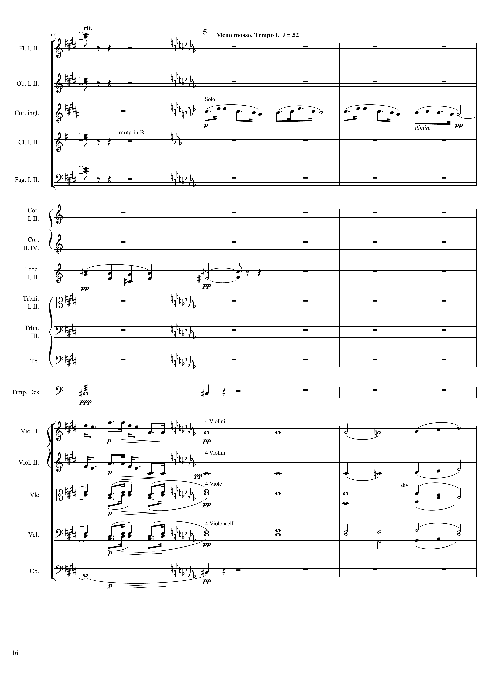
harm
harm
mel
harm
harm
mel
harm
rhythm
mel
harm
mel
harm
mel
harm
mel
harm
harm

Slide 17
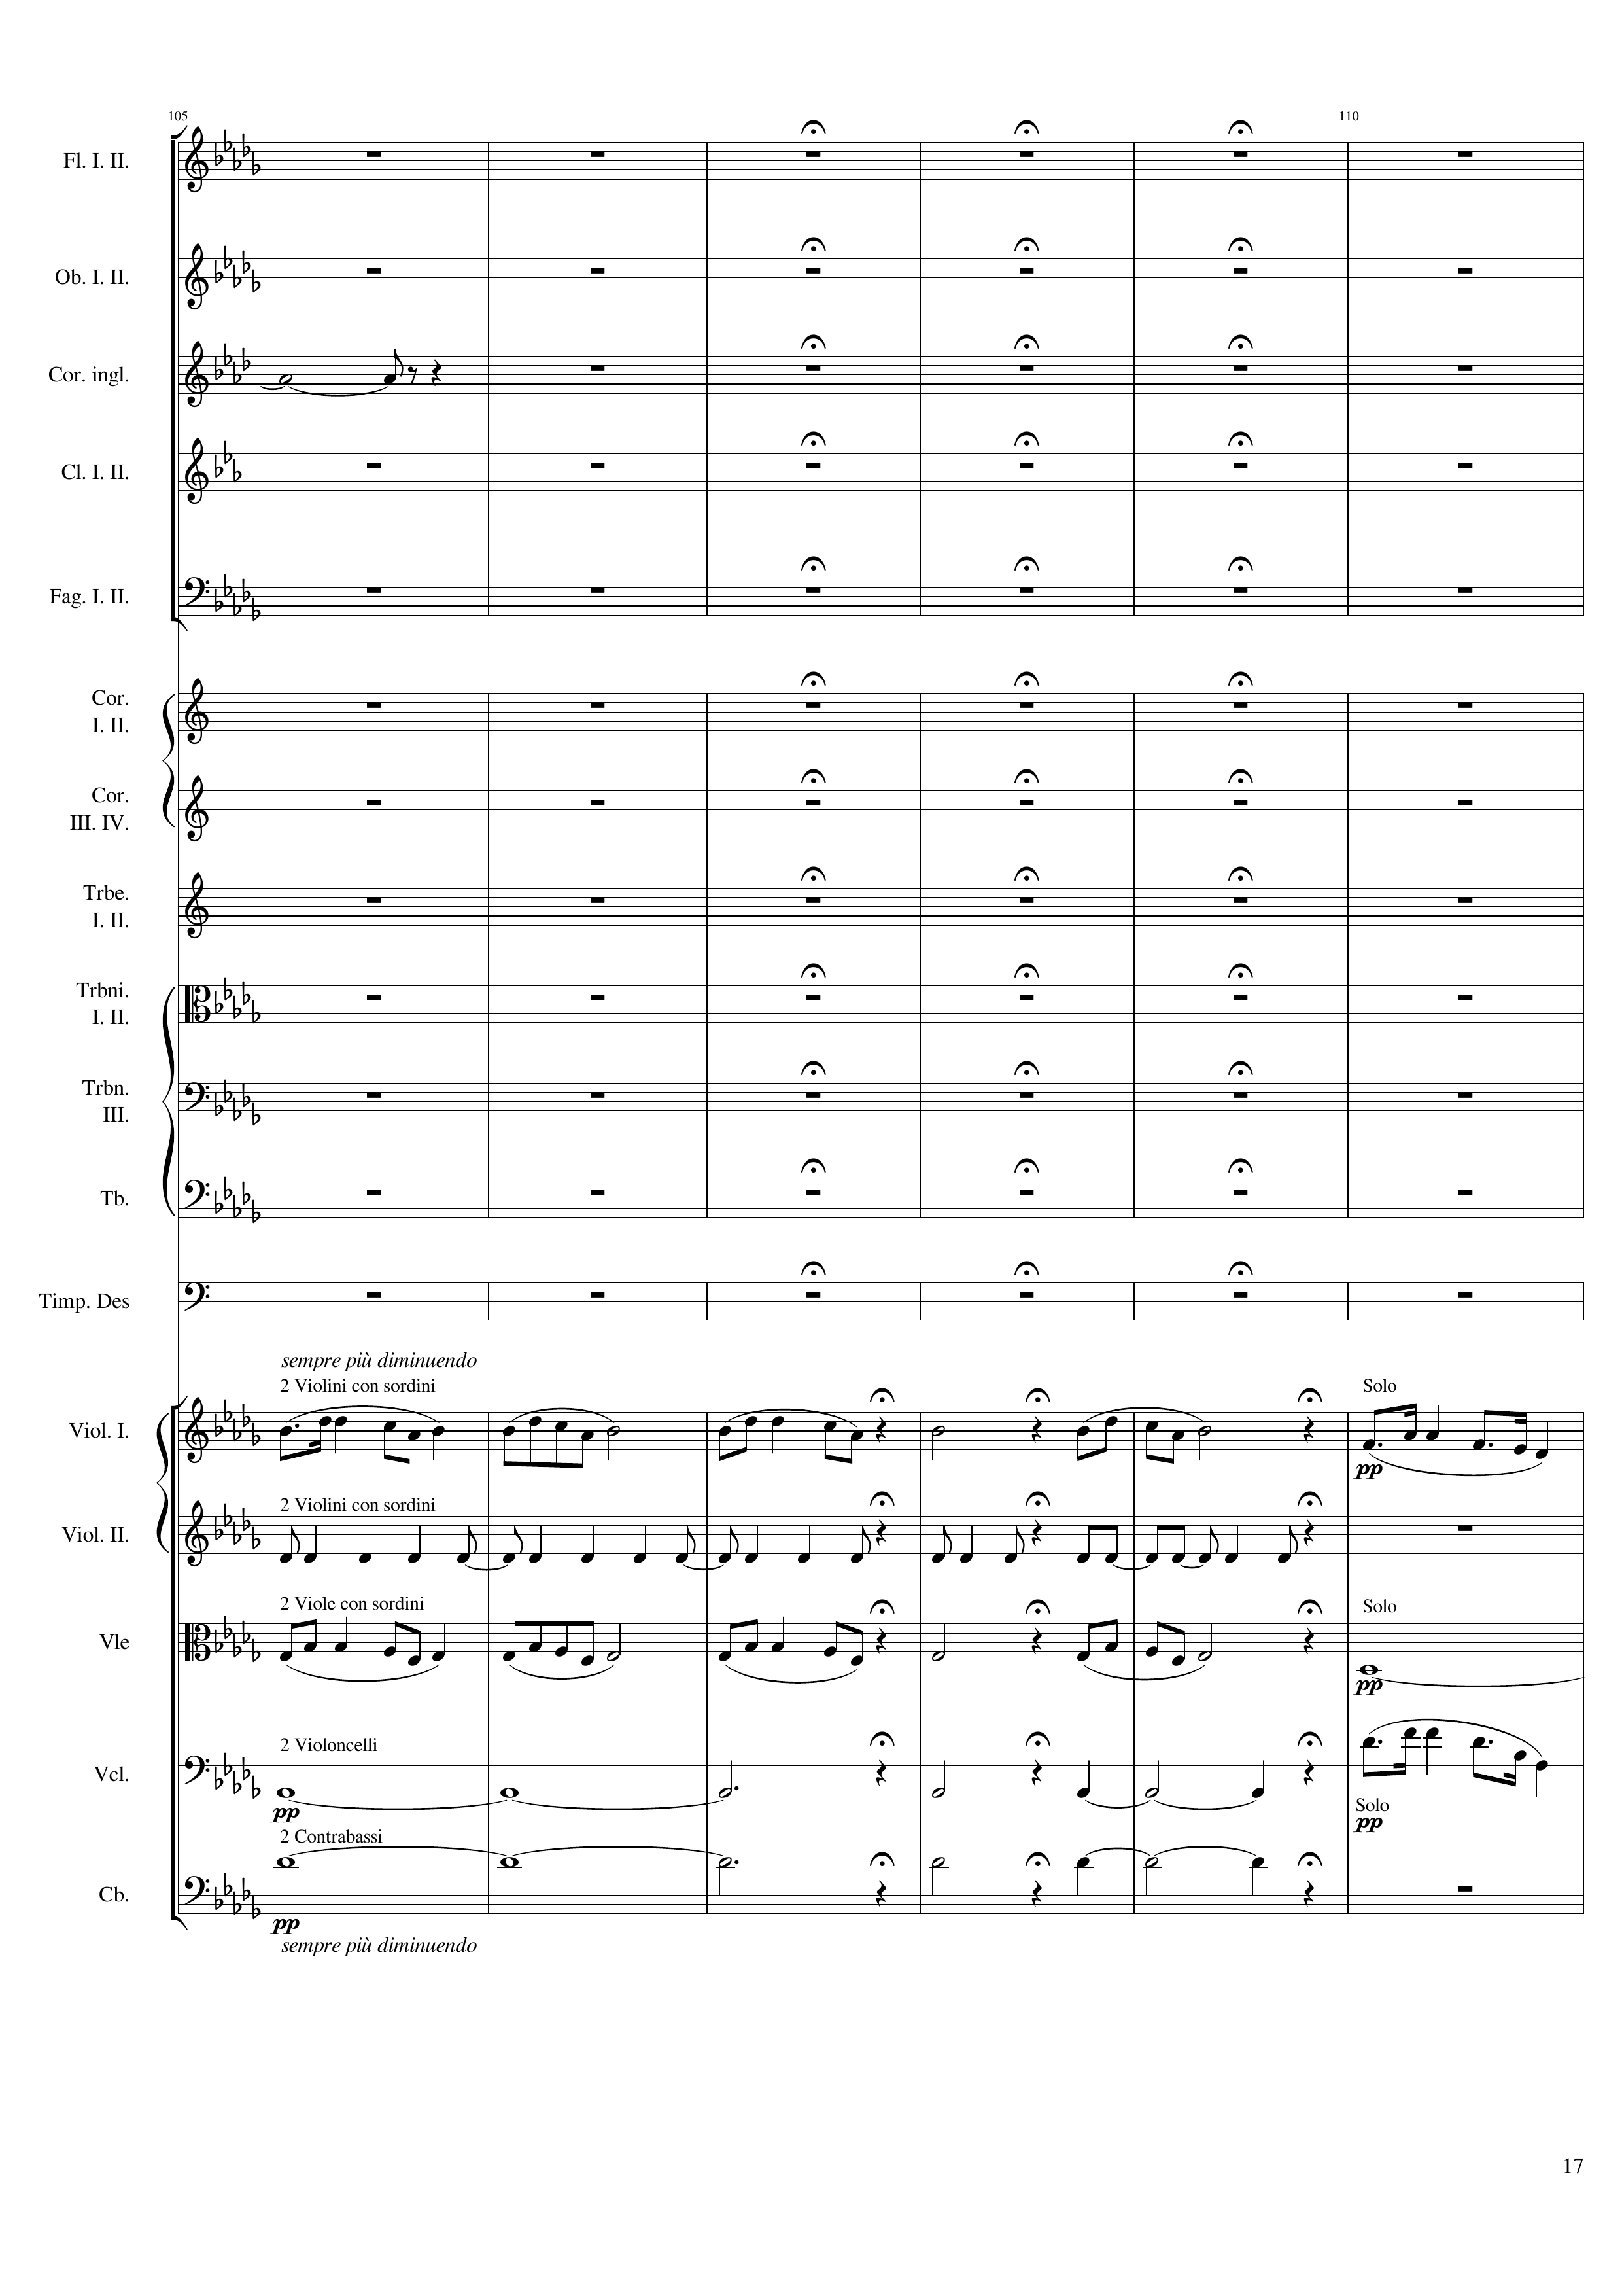
mel
mel
rhythm+harm
mel
harm
harm
mel
harm

Slide 18
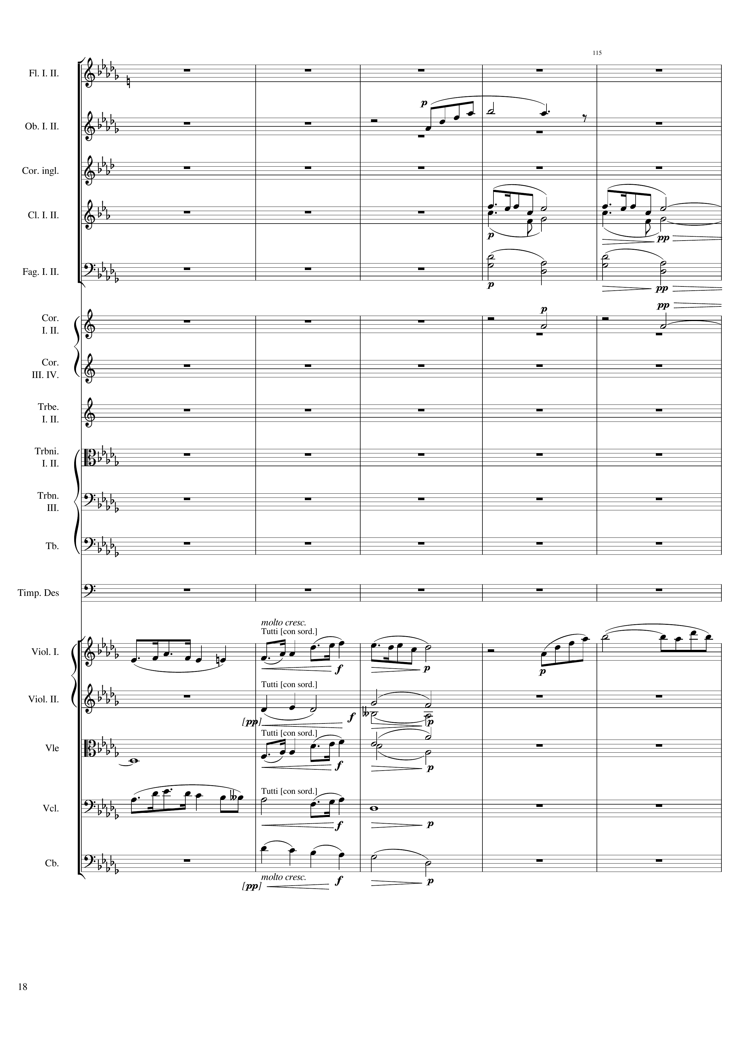
mel
mel
harm
harm
mel
mel
harm
harm
mel
harm
mel
harm
harm

Slide 19
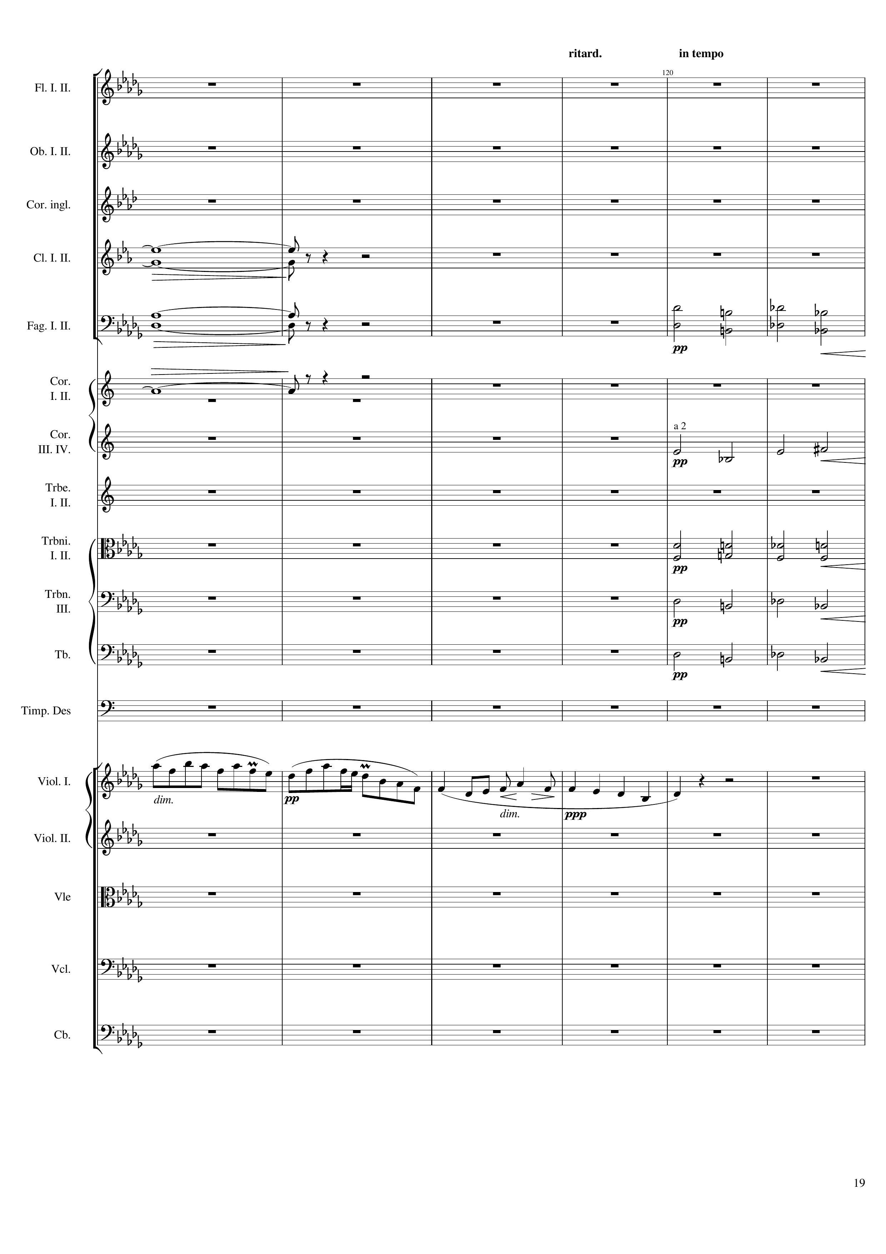
harm
harm
harm
harm
harm
mel
harm
harm
harm
mel

Slide 20
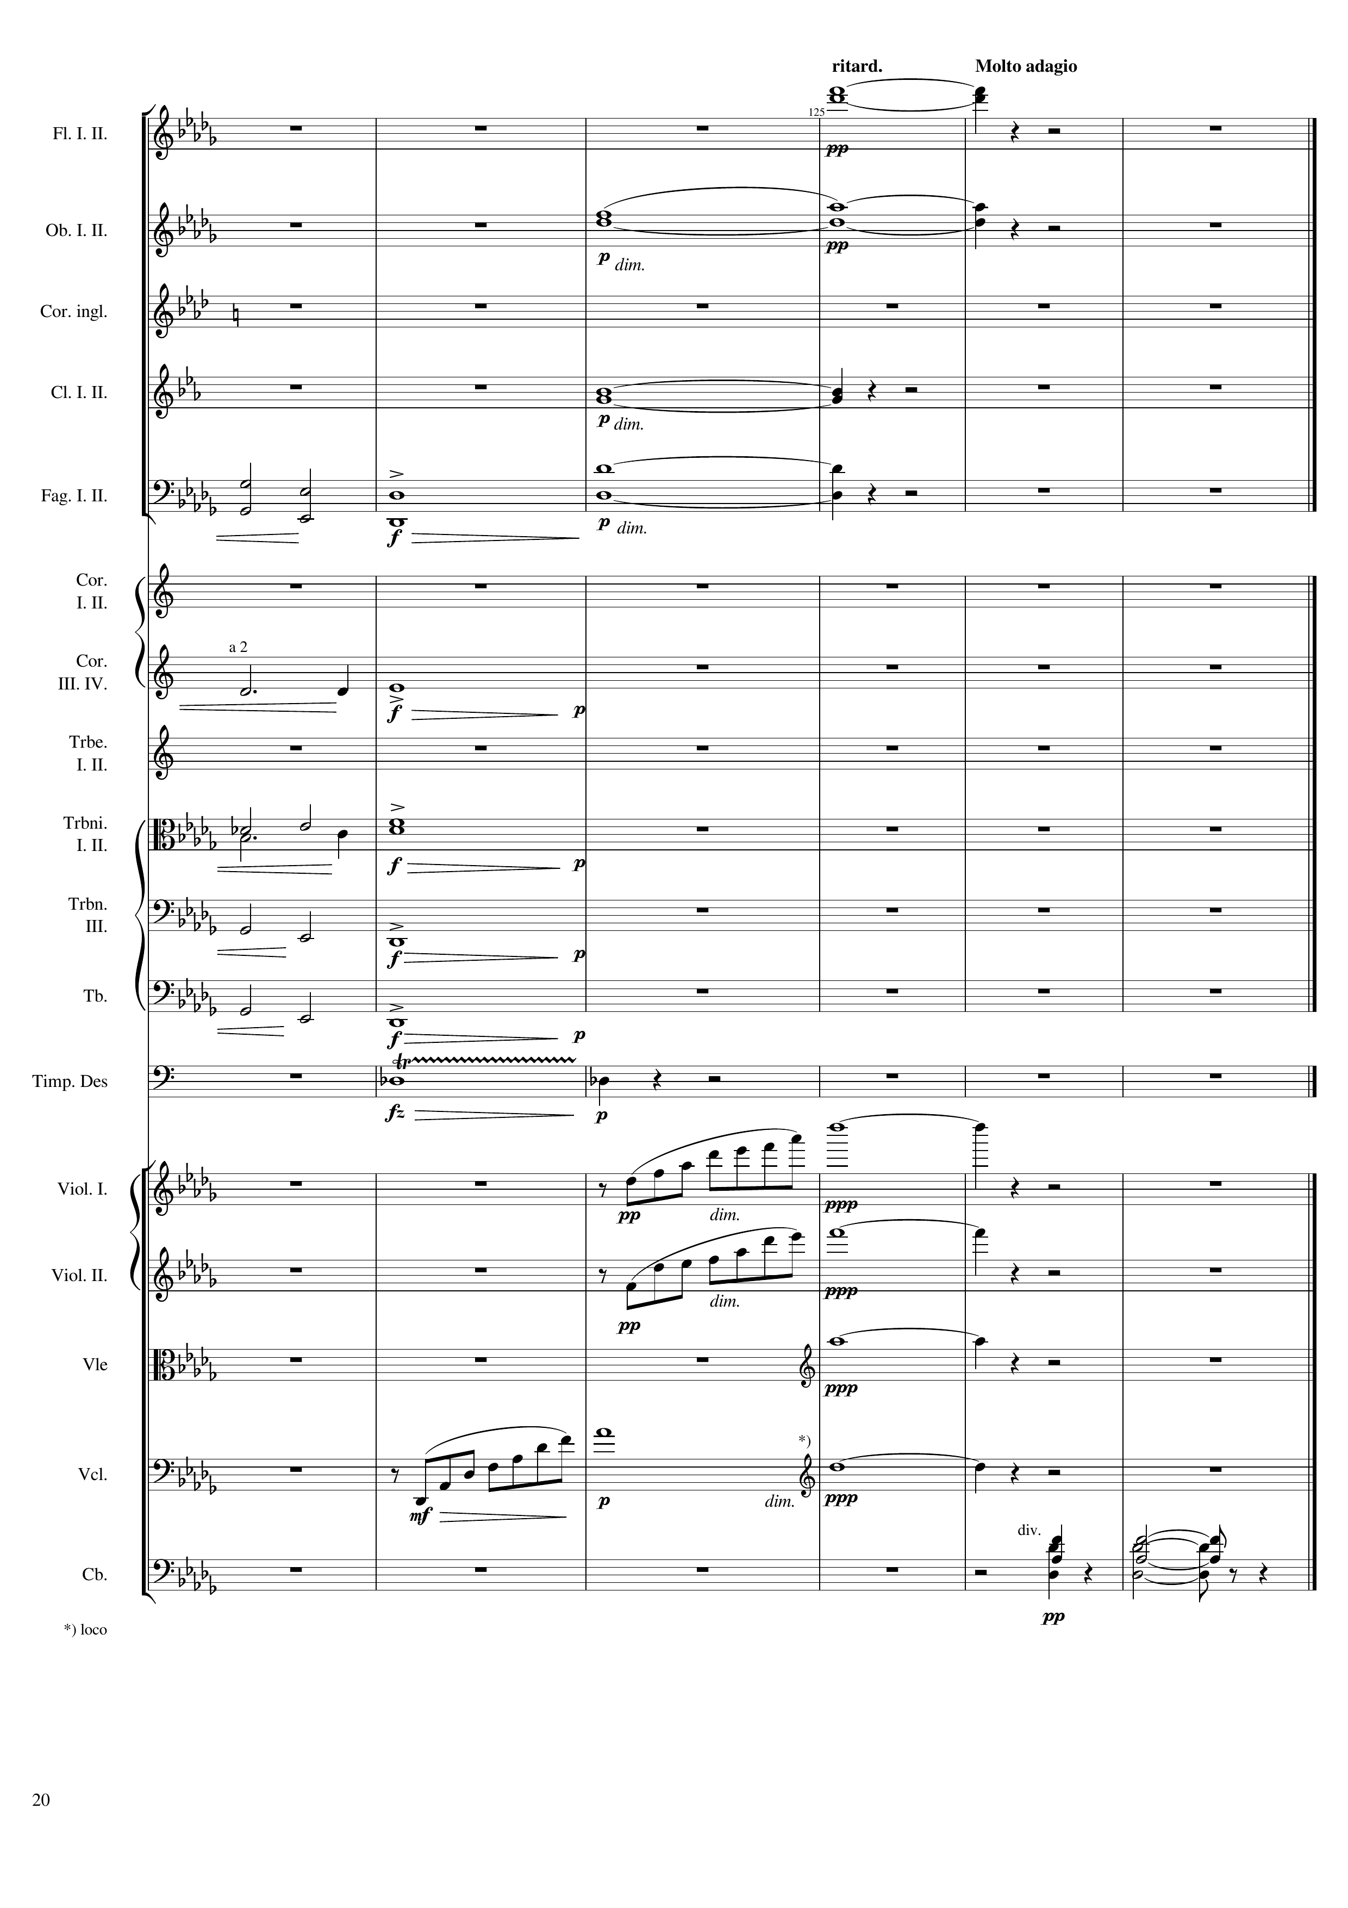
harm
harm
harm
harm
harm
mel
harm
harm
harm
rhythm
mel
mel
harm
mel
harm
mel

